Slide 1

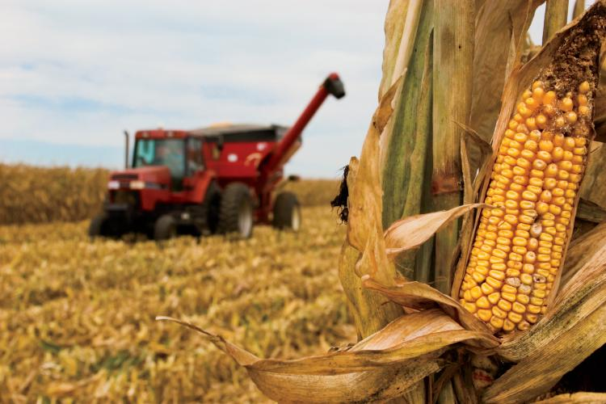
Capstone Project:
Corn Price Model
Tanner Ehmke
CSU Global – MIS581
November 8, 2026

Slide 2
Problem: Sharp Increases in Corn Prices
CoBank, an agricultural lender, can experience sudden strains on liquidity from grain trading customers needing liquidity to pay margin calls on futures contracts.
A 5% price ($0.23 per bushel) rise could hypothetically result in margin calls totaling $1.1 billion.
Notes:
The company shorts (or sells) the commodity in the futures market.
Companies with short positions must pay margin calls to maintain their position when prices rise.
CoBank provides the liquidity for customers’ margin calls, which can be substantial when commodity prices rise sharply.

Slide 3
Research Question
Can trading positions in the Commodity Futures Trading Commission’s weekly Commitments of Traders (COT) report predict a weekly rise of at least 5% in corn futures?
Weekly Corn Price Change (2006-2026)
Notes:
The weekly price increase of at least 5% in corn futures was selected because of the rarity of the occurrence and the sizable effect on liquidity needs at CoBank.
Using weekly corn price data and COT report data from June 13, 2006 to September 22, 2026, there are a total of 1,059 observations of which there were 95 occurrences when weekly prices rose at least 5%, which is 9.0% of all observed weeks.

Slide 4
Data
Variable | Description | Source
Corn price weekly change | The percent change in the corn price in one week. | CME Group
Commercial net position weekly change | Week-over-week change in the net trading position (longs minus shorts) held by producers, merchants, processor, and users. | CFTC
Commercial net position as a percent of open interest | Percentage of open interest represented by the net position held by producers, merchants, processor, and users. | CFTC
Managed money net position weekly change | Week-over-week change in the net trading position (longs minus shorts) held by managed money traders. | CFTC
Managed money net position as a percent of open interest | Percentage of open interest represented by the net position held by producers, merchants, processor, and users. | CFTC
Notes:
Sanders et al. (2009) note it is possible that traders’ positions have a market impact when they reach extreme levels.
Smales (2022) notes that trader positions appear to be more informative when the market prices are at the 52-week high where commercial traders tend to be negative feedback traders while non-commercial (managed money) traders tend to be momentum traders.

Slide 5
Research Design in SAS Studio
Binary logistic regression
  Prices rose at least 5% (code = 1)
  Prices did not rise at least 5% (code = 0)
Multicollinearity test
  Chronological walk-forward validation
Significance tests
  P-value
  Chi-squared for the likelihood ratio (LR χ²)
Prediction power tests
  Matthews correlation coefficient (MCC)
  Accuracy
  F₁ score
  Sensitivity
  Specificity
  Precision
  Cohen's kappa
  AUC-ROC - Area under the curve of the receiver operating characteristic curve
  PR-ROC - Precision-recall curve for binary classifications
Notes:
Because weekly increases of at least 5% in corn futures prices are infrequent, precision and recall will receive particular attention.
A potential statistical challenge is multicollinearity among the four independent variables.
Changes in commercial and managed money net positions may be correlated because futures market participants hold offsetting positions.
Net positions expressed as a percentage of open interest may be correlated with their underlying net positions. High multicollinearity can increase the standard errors of regression coefficients and make it difficult to identify the independent contribution of individual predictors.
Variance inflation factors (VIFs) using chronological walk-forward validation was used to assess relationships among independent variables.

Slide 6
Combined Model was Strongest
 | Cutoff | Accuracy | Sensitivity | Specificity | Precision | NPV | F1 | MCC | Cohens_Kappa | AUC_ROC | AUC_PR
Commercial position change | 0.5 | 0.909 | 0.063 | 0.993 | 0.462 | 0.915 | 0.111 | 0.145 | 0.092 | 0.767 | 0.259
Commercial percent of open interest | 0.5 | 0.910 | 0 | 1.000 | N/A | 0.910 | 0 | 0 | 0 | 0.672 | 0.171
Managed money position change | 0.5 | 0.910 | 0 | 1.000 | N/A | 0.910 | 0 | 0 | 0 | 0.614 | 0.136
Managed money percent of open interest | 0.5 | 0.910 | 0 | 1.000 | N/A | 0.910 | 0 | 0 | 0 | 0.552 | 0.121
Combined Model | 0.5 | 0.911 | 0.074 | 0.994 | 0.539 | 0.916 | 0.130 | 0.175 | 0.110 | 0.808 | 0.299
Source: SAS Studio

Slide 7
But Prediction Success is Weak
Model | N | True Positive | False Positive | True Negative | False Negative
Commercial position change | 1058 | 6 | 7 | 956 | 89
Commercial % of open interest | 1058 | 0 | 0 | 963 | 95
Managed money position change | 1058 | 0 | 0 | 963 | 95
Managed Money % of open interest | 1058 | 0 | 0 | 963 | 95
Combined model | 1058 | 7 | 6 | 957 | 88

Slide 8
Limitations and Recommendations
Small Number of Outcomes
  The dependent variable focuses exclusively on price increases of at least 5%.
  Smaller price changes are not taken into consideration.
Limited Scope
  Trading data is a very narrow dataset.
  Include other data sources.
Lower the cutoff rate in the classification performance
  The cutoff rate of 0.5 is too high.
  Lowering the threshold increases the number of occurrences to test.
Control for seasonality
  The planting and growing seasons tend to see the highest levels of volatility.

Slide 9
Conclusion
Poor Reliability: None of the models are a reliable tool for business purposes in their current form.
Business Risk: Missing a major corn-price rally with a false negative may be more costly to the company’s reputation among customers and could threaten future business.
Further Evaluation: Because of the low prediction power of the model, further analysis needs to be done to evaluate the variables or the model.

Slide 10
References
Chicco, D., & Jurman, G. (2022). The ABC recommendations for validation of supervised machine learning results in biomedical sciences. Frontiers in Big Data, 5, Article 979465. https://www.frontiersin.org/journals/big-data/articles/10.3389/fdata.2022.979465/full
CME Group. (2026). Corn futures contract specifications. https://www.cmegroup.com/markets/agriculture/grains/corn/specs
Commodity Futures Trading Commission. (2026). Commitments of traders. https://www.cftc.gov/MarketReports/CommitmentsofTraders/index.htm
Fishe, R. P. H., Janzen, J. P., & Smith, A. (2014). Hedging and speculative trading in agricultural futures markets. American Journal of Agricultural Economics, 96(2), 542–556. https://arefiles.ucdavis.edu/uploads/filer_public/2014/06/19/hedging-and-speculative-trading-in-agricultural-futures-markets-final1.pdf
He, X., Serra, T., & Garcia, P. (2021). Resilience in flash events in the corn and lean hog futures markets. American Journal of Agricultural Economics, 103(2), 743–764. https://onlinelibrary.wiley.com/doi/10.1111/ajae.12146
Kartikasari, M., & Nafalana, R. (2023). Predicting stock markets using binary logistic regression based on Bry-Boschan algorithm. Jurnal Varian, 6(2), 127–136. https://journal.universitasbumigora.ac.id/index.php/Varian/article/view/2385
Murong, J., Feng, W., Shao, S., Li, Y., Hu, L., & Yang, Q. (2025). A quantitative strategy for predicting stock upside probability based on logistic regression and multi-factor models. In Proceedings of the 2025 International Conference on Artificial Intelligence and Digital Finance (AIDF '25) (pp. 86–92). Association for Computing Machinery. https://dl.acm.org/doi/10.1145/3764727.3764743
Polonsky, M. J., & Waller, D. S. (2018). Designing and managing a research project (4th ed.). SAGE Publications.
Saito, T., & Rehmsmeier, M. (2015). The precision-recall plot is more informative than the ROC plot when evaluating binary classifiers on imbalanced datasets. PLOS ONE, 10(3), Article e0118432. https://journals.plos.org/plosone/article?id=10.1371/journal.pone.0118432
Sanders, D. R., Irwin, S. H., & Merrin, R. P. (2009). Smart money: The forecasting ability of CFTC large traders in agricultural futures markets. Journal of Agricultural and Resource Economics, 34(2), 276–296. https://ageconsearch.umn.edu/record/54547
Senaviratna, N. A. M. R., & Cooray, T. M. J. A. (2019). Diagnosing multicollinearity of logistic regression model. Asian Journal of Probability and Statistics, 5(2), 1–9. https://journalajpas.com/index.php/AJPAS/article/view/96
Smales, L. A. (2022). Trading behavior in agricultural commodity futures around the 52‑week high. Commodities, 1(1), 3–17. https://www.mdpi.com/2813-2432/1/1/2

